Slide 1
De-extinction
Grace Callister

Slide 2
Overview
History
Pictures
Science behind it
Impacts
Pros
Cons
Summary
Citation

Slide 3
History
Who came up with De-extinction?
It first started with the german brothers Lutz and Heinz Heck in the 1930s who tried to revive an extinct species
Later inspired the quagga project which was led by Reinhold Rau who tried to create a new breed similar to the extinct quagga
Colossal Biosciences is working to bring back the woolly mammoth
Notes:
Lutz and Heinz Heck - They were trying to revive to extinct species called the aurochs (wild ancestor of a cow) and the tarpan (wild ancestor of a horse). What they produced was a lookalike of their ancestor which is now called “Heck Cattle” or “Heck Horse”.
The quagga project was led by Reinhold Rau. The quagga project was an attempt to use selective breeding to achieve a breeding lineage of Burchell’s zebra which is supposed to resemble a quagga. A quagga is an extinct subspecies of plain zebras.
A Dallas based company called Colossal Biosciences are trying to de-extinct the woolly mammoth. What they are doing is using DNA from Asian elephants and DNA recovered from Woolly Mammoths and trying to reengineer the genome of the Asian elephant to reflect the Woolly Mammoth. Colossal Bioscience also announced that they are trying to bring back other extinct species like the dodo bird and Tasmanian Tiger.

Slide 4
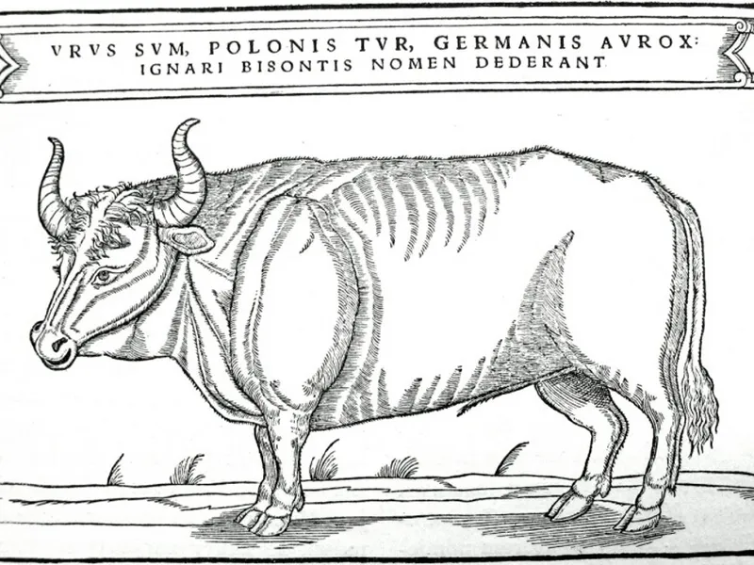
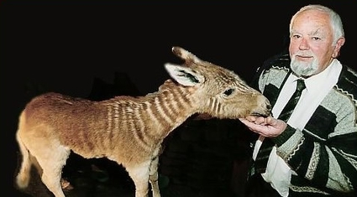
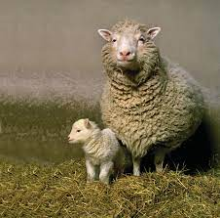
Sub species of quagga
Heck Cattle
Notes:
The Heck cattle is what Lutz and Heinz Heck created while trying to revive an extinct species. The Quagga is what Reinhold Rau tried to revive but he created a breeding lineage of Burchell’s zebra.

Slide 5
History
What is the science behind de-extinction?
Selective breeding
Genetics
Reproductive cloning technologies
Somatic cell nuclear transfer
Notes:
Selective breeding is done by choosing specific characteristics from a set of parents to breed together and produce offspring. When used for de-extinction selective breeding can be used to get certain traits over generations. Genetics are involved with de-extinction because scientists can extract DNA from the preserved remains of the extinct species they wish to revive, to obtain the needed genetic material for de-extinction. Scientists also use genetic engineering techniques that can modify the DNA of living species that can resemble the extinct species. De-extinction could eventually be possible because of techniques that can manipulate DNA and genomes. Reproductive cloning is done by removing a somatic cell from an animal that is going to be copied. Then the DNA is transferred from the donuts somatic cell to a an egg cell that has its own DNA-containing nucleus removed. Somatic cell nuclear transfer can be used for de extinction when scientists use it to preserve the genetic diversity of extinct species. SCNT allows for the recreation of individuals with the exact genetic makeup of the extinct species, helping to maintain genetic diversity within the population.

Slide 6
What will it impact?
Environment
Compromise preserving species that are alive now
Take resources away from endangered species
Notes:
If all focus goes on de-extinction then it could compromise the life of other species. It could lead to a loss of species, habitat destruction, and habitat degradation.

Slide 7
Pros
Conserves biodiversity
Contribute to research
Potential medical advancements
Notes:
De-extinction could help conserve biodiversity by restoring species that have been lost. This is important for ecosystem health. Studying extinct species could help contribute more information to things such as genetics, evolution, and ecology. With research focused on de-extincting species there could potentially be new discoveries in areas such as medicine, biotechnology and genetic engineering.

Slide 8
Cons
Impact on existing species
Expensive
Is it ethical?
Notes:
A con of de-extinction is that putting resources towards de-extincting animals could to less resources available for species that are already alive but are endangered. They could also disrupt ecosystems by competing with other species for food and resources. De-extinction can cost millions of dollars and the money is usually taken out of a conservation fund that could be helping species on earth now. There are ethical concerns with de-extinction. Some people argues that scientists are trying to play “nature’s role” and that bringing back extinct animals could interfere with the ecosystem. People also argue that there could be unintended consequences from de-extinction such as disrupting existing species and food chains being altered. It is also argued that de-extinct species may lack the genetic diversity that is needed to survive in the natural habitat, this could potentially lead to them being more vulnerable to disease and environmental changes.

Slide 9
Summary
Although I see both sides of de-extinction I think I’m mostly against it. Although there are advantages to it such as conserving biodiversity, contributing to research, and possibly contributing to medical and technological advancements, I feel like there are more cons than pros. I feel like there is a big ethics concern with bringing back extinct species. I also feel like bringing back extinct species is a lot of use of money that could be used for different things, and de-extinction could also impact species that are alive negatively by having to compete for resources and there being an interference in the ecosystem. So overall, I believe that de-extinction isn’t something that should be pursued.

Slide 10
Citations
De-extinction: a novel and remarkable case of bio-objectification - PMC
De-extinction | Definition, History, Ethics, & Facts | Britannica
Woolly Mammoth de-extinction project underway in Dallas

